Slide 1
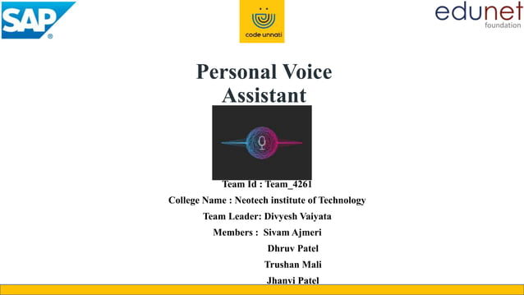
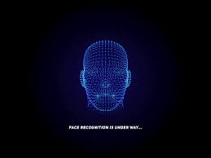
Face Mask Detection Alert System Using Keras and Tensor-Flow
College Name : Lokmanya Tilak College of Engineering
Team Leader : Abhijay Singh
Members :
Abhishek Tiwari
Aniket Gupta
Gopal Prajapati

Slide 2
AGENDA
Problem Statement
Project Overview
Who Are the end User
The Wow factor in our solution
Flow Chart
Result
Conclusion

Slide 3
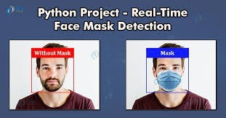
Problem Statement
Overview:
COVID-19 outbreak since 2019 continues to impact lives and businesses.
Key Challenge:
Need for a solution to mitigate the spread of the virus other significant diseases.
Solution Importance:
Wearing face masks significantly reduces viral transmission.

Slide 4
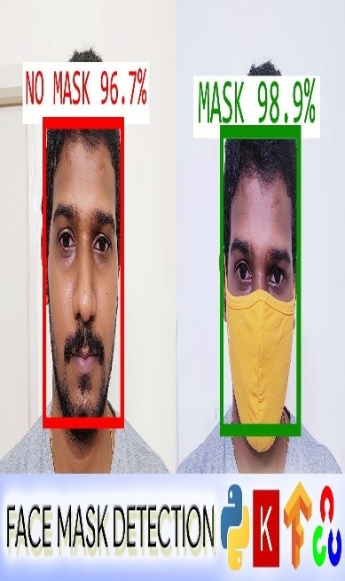
Project Overview
Objective:
Create a robust system for face mask detection.
Technological Approach:
Utilize machine learning and image processing.
Relevance:
Contribute to public health and safety measures.
Innovation:
Integration of cutting-edge technologies for accurate detection.

Slide 5
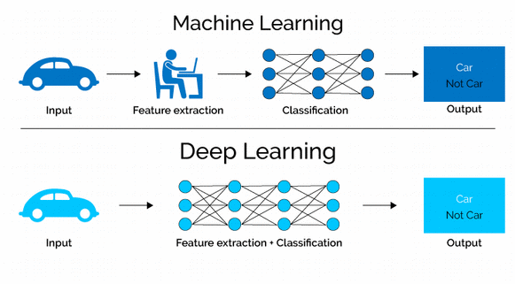
DEEP LEARNING
Nested Hierarchy:
Deep learning forms a nested hierarchy of concepts.
Brain Mimicry:
AI mimics human brain for object detection, language.
Object Recognition:
Deep learning excels in accurate object detection tasks.
Language & Decisions:
Used for language translation, decisions in AI applications.

Slide 6
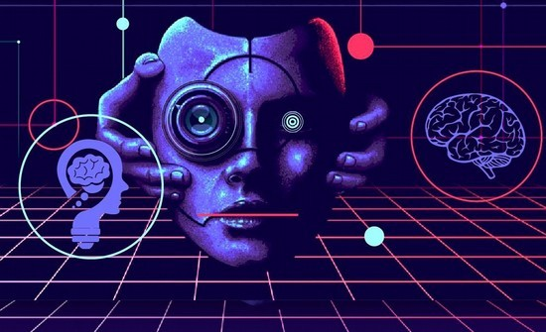
COMPUTER VISION
Computer Vision (CV):
Seeks to make computers comprehend digital image content.
Unsolved Challenge:
Complex due to limited biological vision understanding.
Dynamic Perception:
Challenges arise in perceiving a dynamically varying world.
Photographs and Videos:
Focus on interpreting digital images in photos and videos.

Slide 7


NUMPY AND TKINTER
NumPy is a Python library for numerical operations and array manipulation.
NumPy is the fundamental package for scientific computing with Python.
Tkinter is the standard GUI library for Python. Python when combined with Tkinter provides a fast and easy way to create GUI applications.
Tkinter provides a powerful object-
oriented interface to the Tk GUI toolkit.

Slide 8

OPEN CV
OpenCV- Python is a library of Python bindings designed to solve computer vision problems.
OpenCV supports a wide variety of programming Languages like Python, C++, Java, etc.
It can process images and videos to identify objects, faces, or even the handwriting of a human.

Slide 9
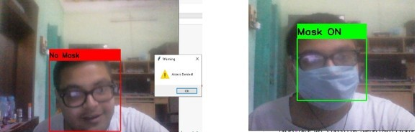
RESULTS
We have applied Convolution Neural Network to train the machine so that it can detect whether the person is wearing Mask or not. The machine shows the correct result when it gets an unknown data, that is, the machine has been trained properly.

Slide 10

CONCLUSION
The implementation of face mask detection contributes to reinforcing safety measures in public spaces.
The system automates the monitoring process, reducing the need for constant human surveillance and ensuring adherence to health guidelines.
Real-time alerts generated by the system provide immediate notifications, enabling timely interventions and fostering a proactive approach to public health.

